Slide 1

Influence of Inflation on Interest in Public Banks
About Data
Model selection & develop
Result
Deniz Parlak

Slide 2
About Project
%50 Web scraping - %50 .csv data (Total 16 column)
3 columns contain NaN values (Total 181 entries).
Financial and economic data
Data source : https://www.tcmb.gov.tr/

Slide 3
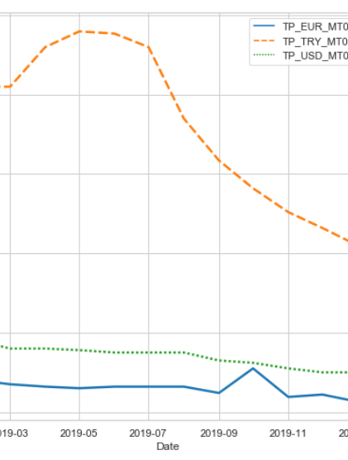
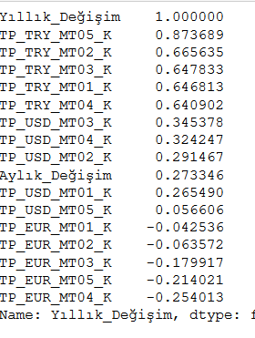
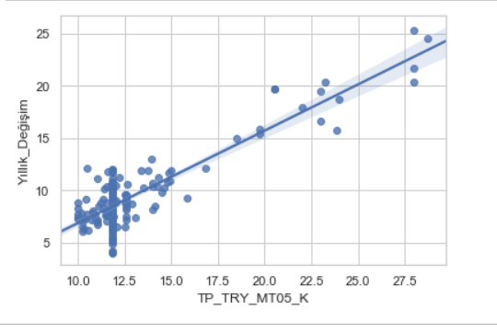
Explore &Understanding the data

Slide 4
Model Selection
Remember 60-20-20 rule
Careful to overfit or underfit
Feature Engineering
Choose best model
Develop model

Slide 5
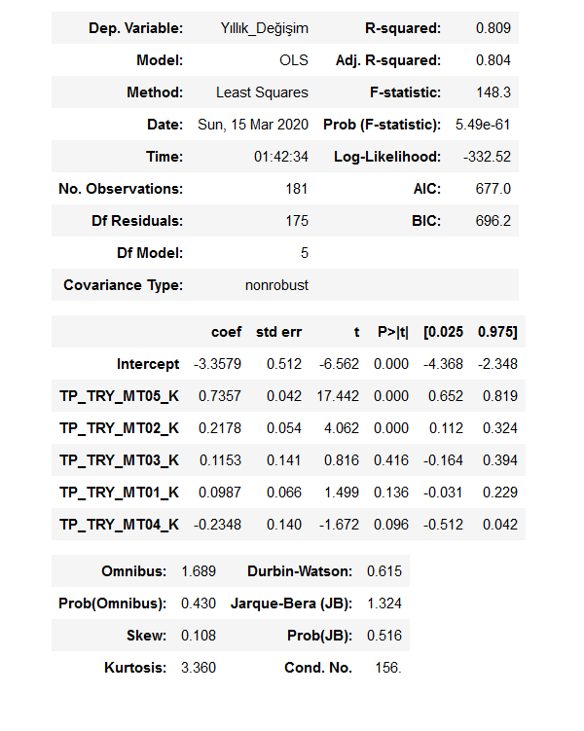
Result
OLS model result with the first form of data and only 4 column

Slide 6
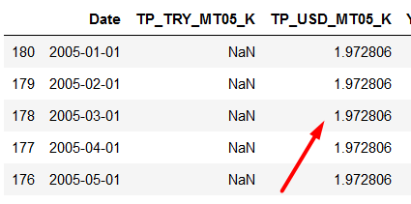
Add some colum for ML
Filled NaN USD-05 column and prepare for ML (Classical Lineer Regression)
NaN values were filled according to some mathematical operations.

Slide 7
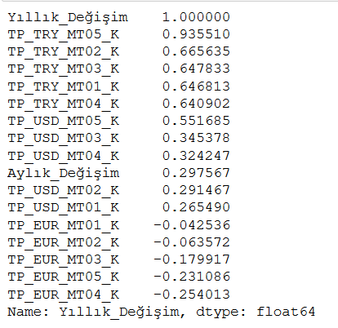
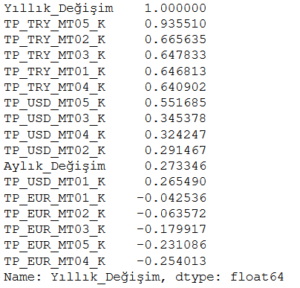
Make a little change
round()
After rounding on the data, the importance of the column increased.

Slide 8
After Change
Before change : r^2 = 0.84
After change : r^2 = 0.88

Slide 9
Results
In its original form and only 5 columns : R^2=0.809
1
Second try (11 column): R^2 0.84
2
Validation try : too close each one (Lineer:0.86 Ridge: 0.862 Poly:0.86 , Lasso: 0.82
3

Slide 10
Last Result
After all trials, we got the best result with Linear Regression.

Slide 11
Thank you for listening

